Slide 1
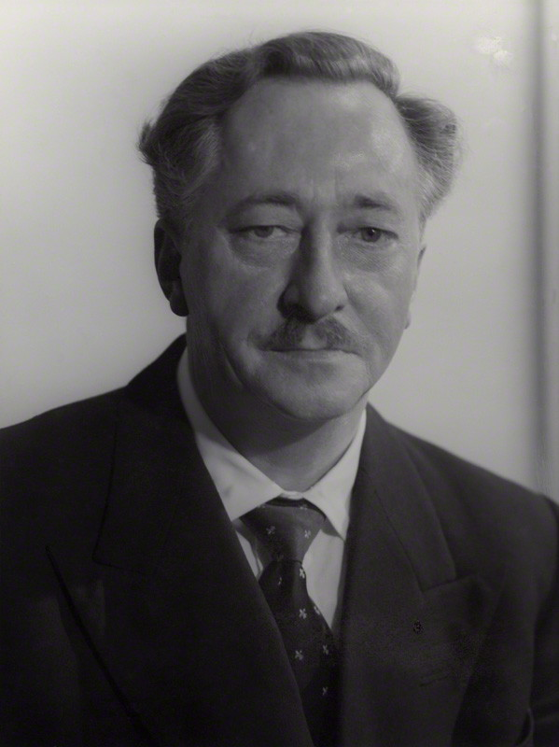
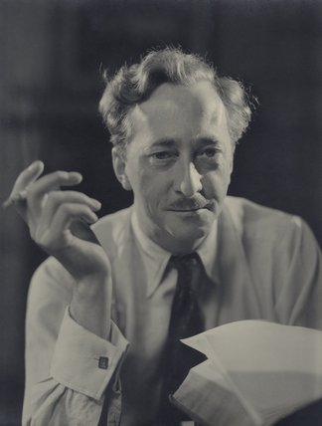
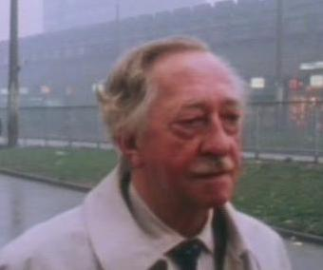
The Life and Works of Walter Greenwood
(1903-1974)

Slide 2
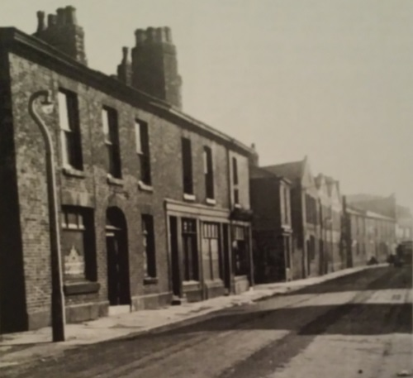
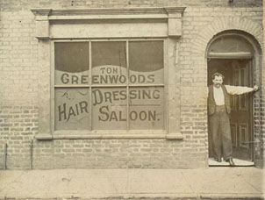
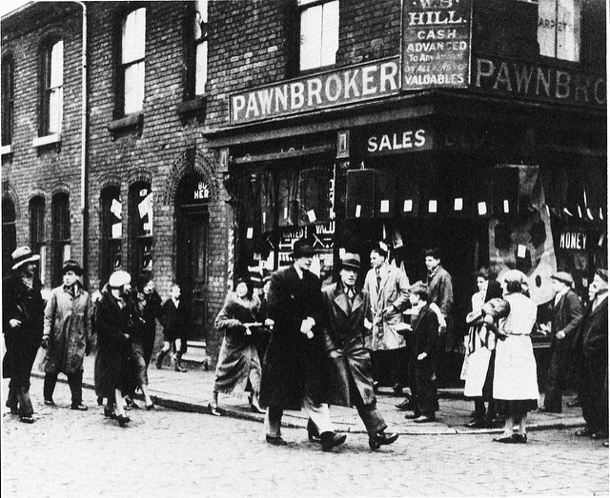
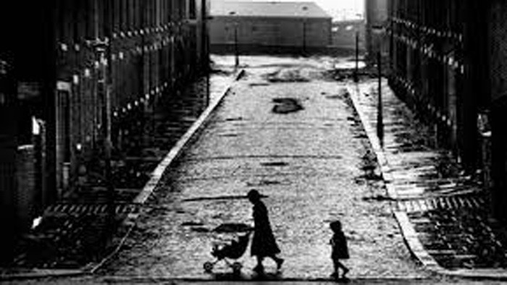
Hanky Park 1903-1935

Slide 3
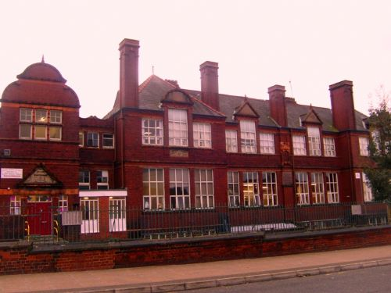
School: 'Langy Road', 1912- 1917
'In the whole of my school career I never won a prize or an attendance certificate
. . . To me the Old School was a place to be avoided, a sort of punishment for being young. . . the teachers’ disgust for us was only equalled by our disgust for them.' (The Old School, 1934, pp. 56-7).
'My schooldays were over and I was free to find a full-time job: I was envied’
(There Was a Time, p.64)

Slide 4
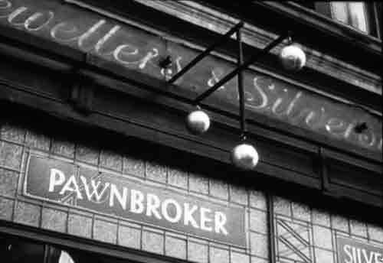
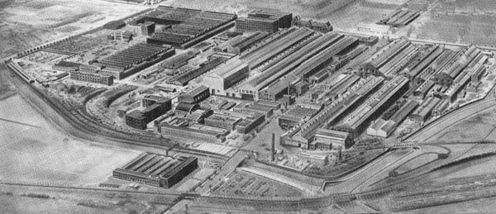
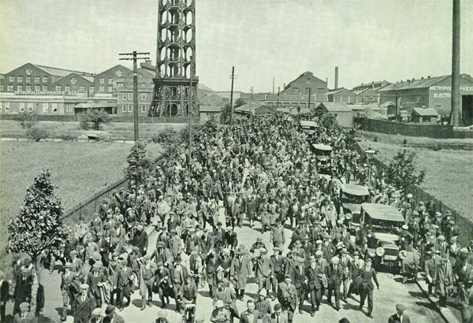
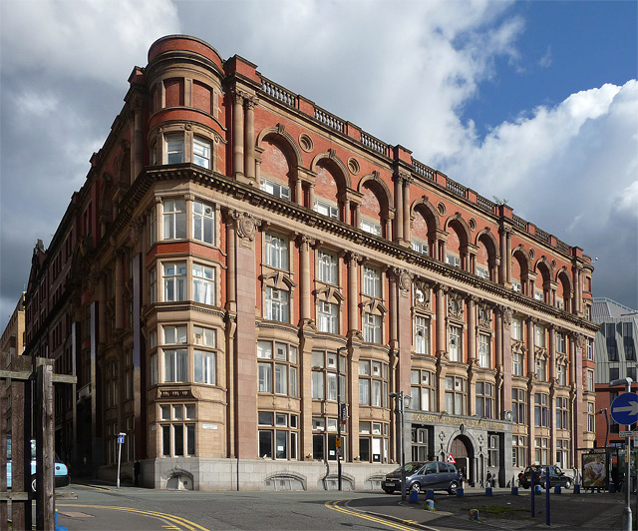
Pawnshop (Pendleton)
Co-Op (Corporation St?)
Stables (Swinton Park)
Trafford Park (Ford, MetroVick/Marlowe's)
Jackson's Emporium
Working Man: 1917-1928

Slide 5
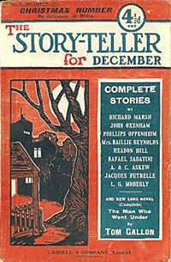
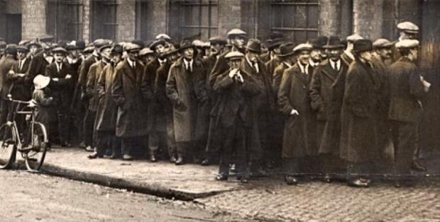
Un-working Man - Dole and Writing
1929-1932
1931: story ('A Maker of Books') accepted by The Story-Teller magazine: paid 25 guineas: 'a pound a week for half a year'.
His 1st story was 'Jack Cranford's Wife' - later called 'The Cleft Stick'.
Ethel Mannin advises that short stories won't pay
Rewrites short stories as a novel
1932. Novel: Love on the Dole accepted by Jonathan Cape: ' Dear Sir, We will publish your novel... I was on the threshold of a wonderful year though this I did not know... (There Was a Time, p. 204).
'Burning as I was with political bias for the establishment of social reform, I assured myself ... that this fervid desire would be shared by editors in London . . . Now and then a kindly disposed editor would add a note to his rejection slip saying that, while he thought the story good of itself, its subject matter was not the sort of thing to interest readers who paid their money for romance, entertainment and excitement. If I cared to send something of a lighter nature, he would be happy to read it'. (There Was a Time, p.176)

Slide 6
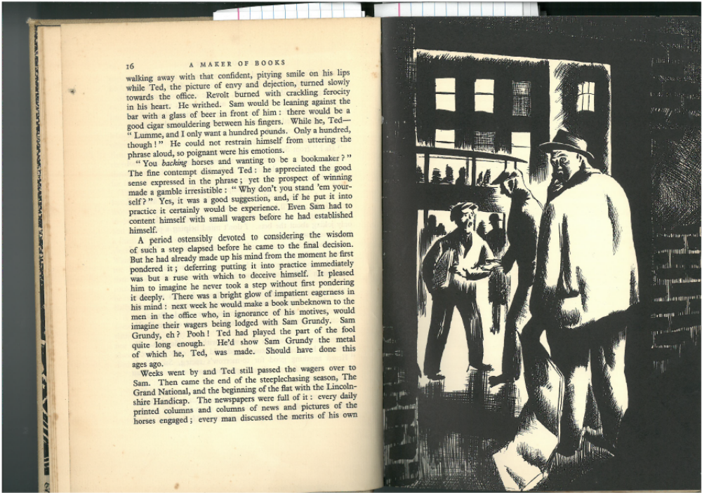
First published Story: 'A Maker of Books'
' " Now Ma,", he cried with an expression of amused tolerance: "What do you know about bookmaking, eh? What do you know? Nothing. Don't I tell you I could pay you back in two months? Yes, and pay you back double. You wouldn't need to have to work again. He held out his hands and smiled, encouragingly.'(p. 18)

Slide 7
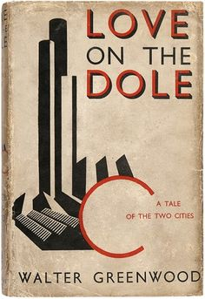
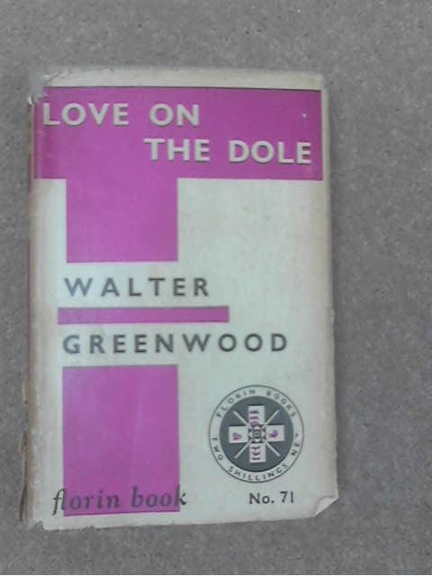
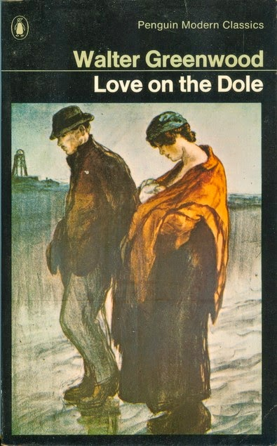
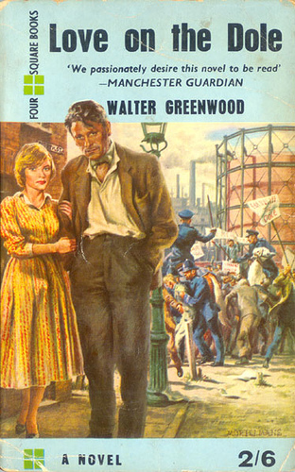
Love on the Dole, 1933
Set in Hanky Park, Salford, 1923-1931
Hardcastle family: Mr and Mrs H; Harry and Sally
Larry Meath
Sam Grundy
Ned Narky
The chorus / '3 witches': Mrs Bull, Mrs Dorbel, Mrs Nattle, Mrs Jikes

Slide 8
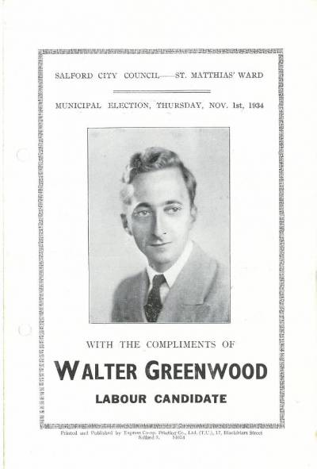
1933-36: Fame and Money
1934 Elected city councillor for St Matthias Ward (winning by 750 votes)
1934 Contract for new novel His Worship the Mayor
1935-6: article commissions:
  ‘Poverty and Freedom’ and ‘On the Dole’ for The Spectator
  ‘Return of a Revolutionary’ (a short story) for Labour – a Magazine for All Workers
  a guest on the BBC radio programme, ‘In Town Tonight’, where ‘he spoke briefly but interestingly of his early days of struggle ....[and] then the writing of Love on the Dole in all sorts of odd corners, upon scraps of paper, including wall paper.’ (Salford Reporter, Feb 1935)
1935: Goes to Paris as delegate to the Writers' Congress
'We passionately desire this novel to be read; it is the real thing. Mr Greenwood is a Salford man. . . he has been on the dole. He knows and he can tell . . .In a first novel he communicates with an ease which makes him, in sheer readability, the superior of most experienced novelists.' Manchester Guardian, Harold Brighouse 30/6/1933.
‘Here is a Dickens of Our Time’, Edith Sitwell, Sunday Referee, 24/3/1935

Slide 9
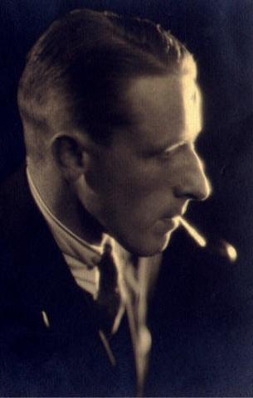

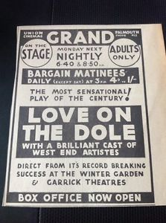
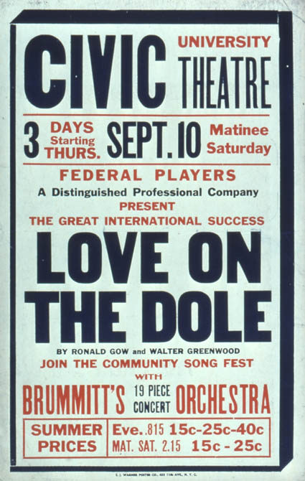
1935 Love on the Dole - the play
With Ronald Gow
Manchester, London, New York, UK national tours 1935-1937 (blue and red companies)
Barrow, Birmingham, Brighton, Brixton, Cambridge, Cardiff, Douglas (Isle of Man), Eastbourne, East Ham, Edinburgh, Finsbury Park, Folkestone, Gateshead, Hackney, Keighley, Leeds, Lewisham, Liverpool, Luton, Manchester, New Cross, Penge, Plymouth, Poplar, Rotherham, Salford, Scarborough, Sheffield, Sunderland, Swansea, Walthamstow and Woolwich...

Slide 10
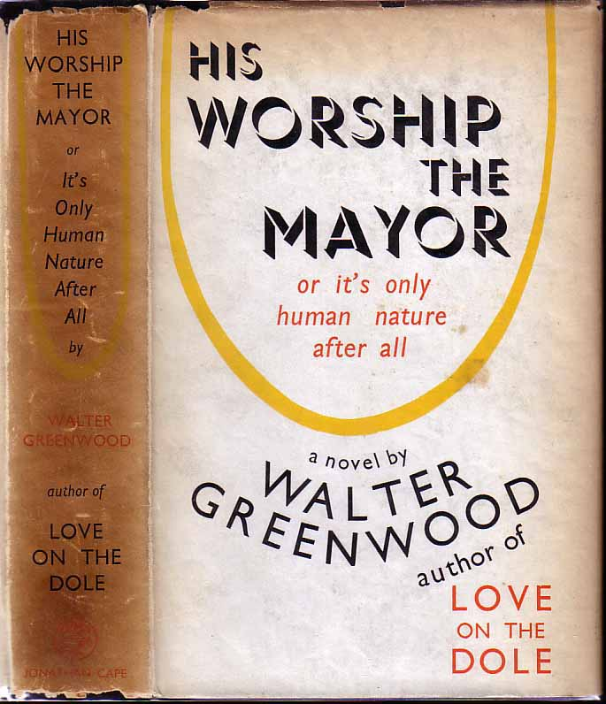
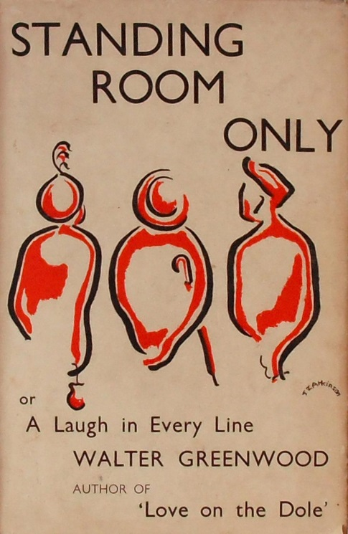
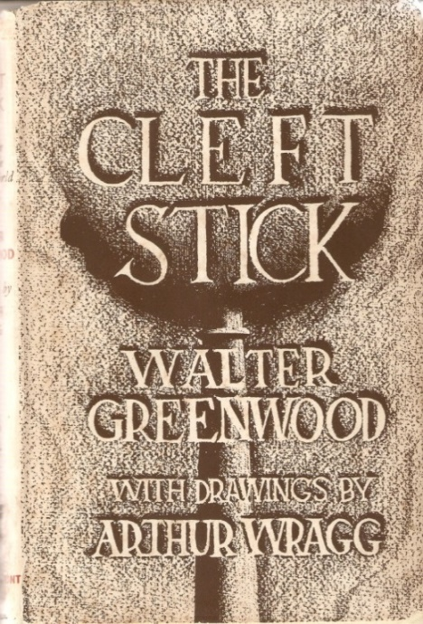
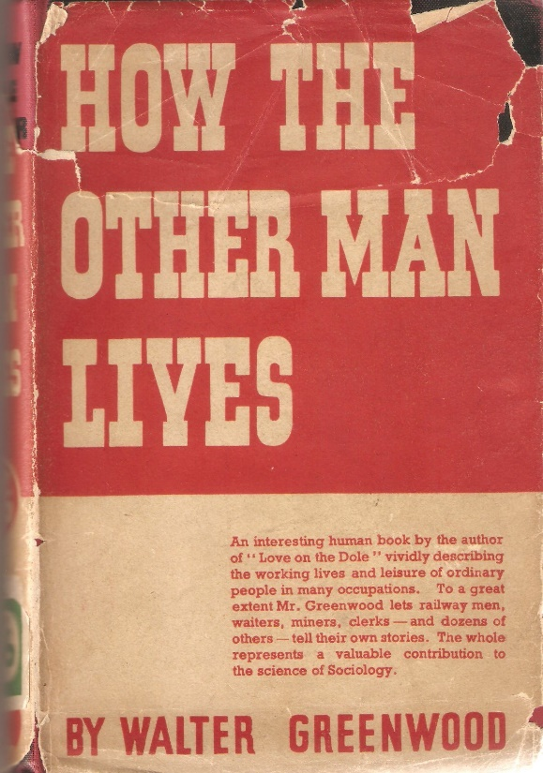
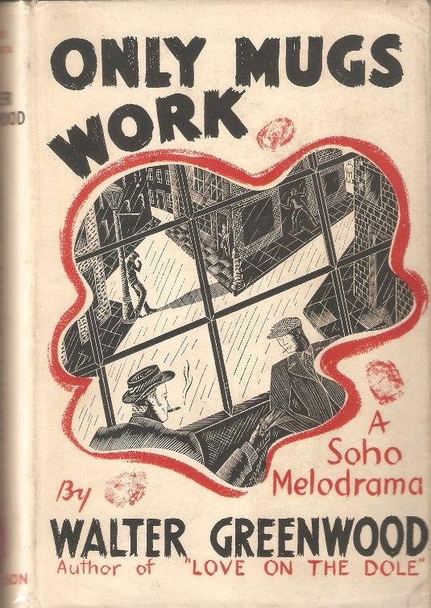
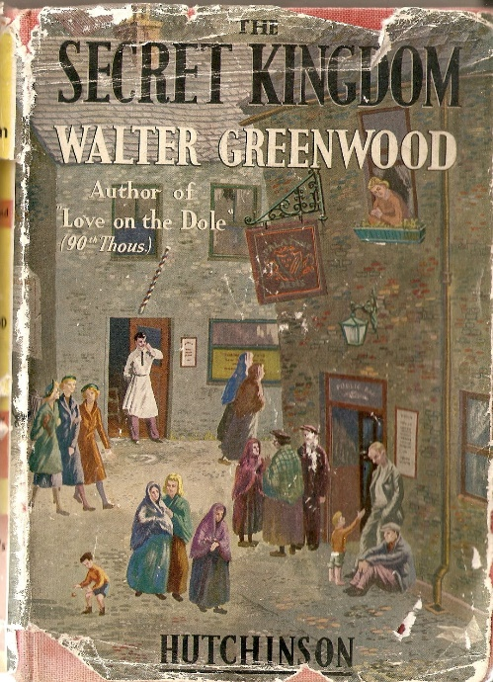
Professional Writer 1934-1940
1935,
1936,
1937,
1938, 1938,
1939

Slide 11
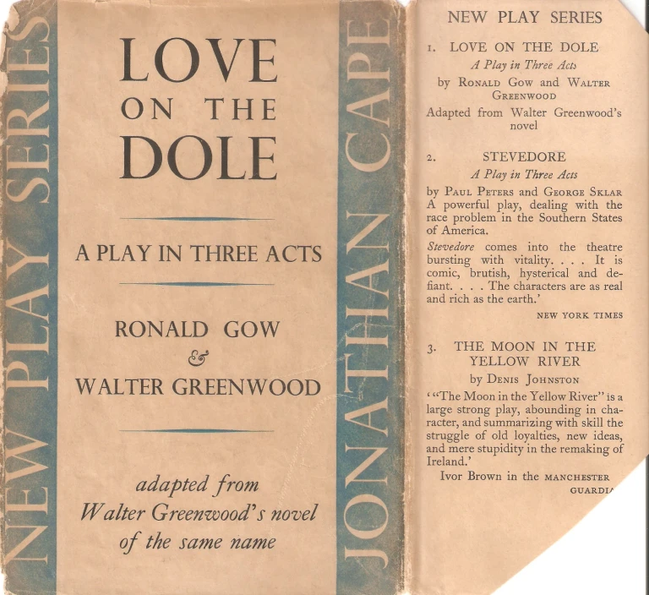
Salford-London-Cornwall-New York
1935 moves to London
Play published
Works for half the year in Polperro
Meets Arthur Wragg
1936 New York - Broadway production of LoD
Meets Pearl Alice Osgood
Breach of Promise Case brought by Alice Myles
1937 marries
1938 co-founds GreenPark Ltd

Slide 12
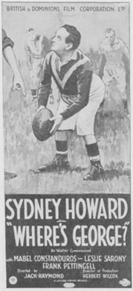
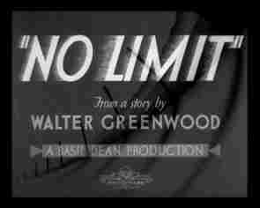
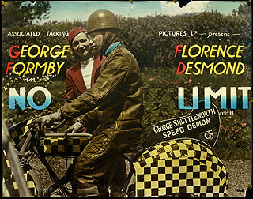
Greenwood and Film
1935 Where's George?
1936: No Limit
BUT 1935; 1936: LoD scenario submitted to BBFC:
Colonel Hanna: 'A very sordid story in very sordid surroundings. The language throughout is very coarse and full of swearwords, some of which are quite prohibitive. The scenes of mobs fighting the police are not shown in the stage-play, but only described. They might easily be prohibitive. Even if the book is well-reviewed and the stage play had a successful run, I think this subject as it stands would be very undesirable as a film.'
Miss Shortt: 'I do not consider this play suitable for production as a film. There is too much of the tragic and sordid side of poverty and a certain amount of dialogue would have to be deleted and the final incident of Sally selling herself is prohibitive.'

Slide 13
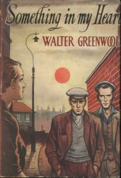
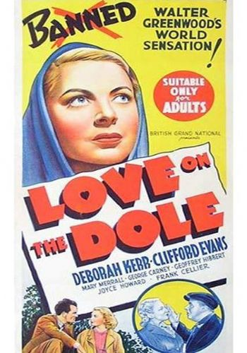
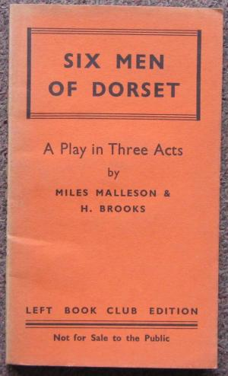
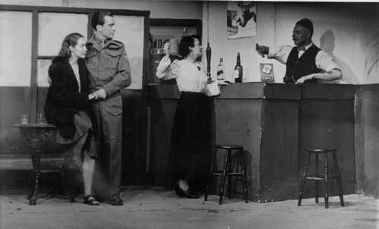
Greenwood's War
1940 Letter to the Manchester Guardian
1940 The FILM, the MOI and the BBFC!
1941 John Baxter; Richard Addinsell; Deborah Kerr
Greenpark documentaries
1943 called up: RASC
Something in My Heart, 1944
(Six Men of Dorset) 1944
The Cure for Love, 1945
Also BBC Radio work: adaptations of LoD and The Cure For Love.

Slide 14
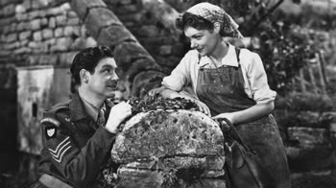
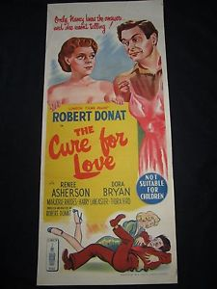
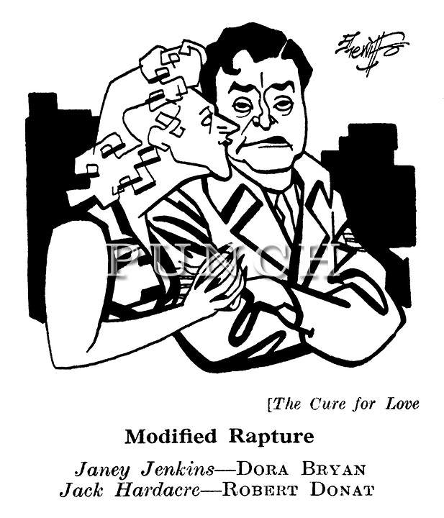
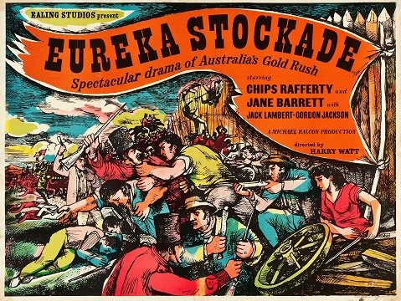
1945-1950: novels, plays, films
1945 play: So Brief the Spring
1949 film: The Cure for Love
1949 film: The Eureka Stockade

Slide 15
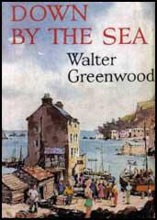
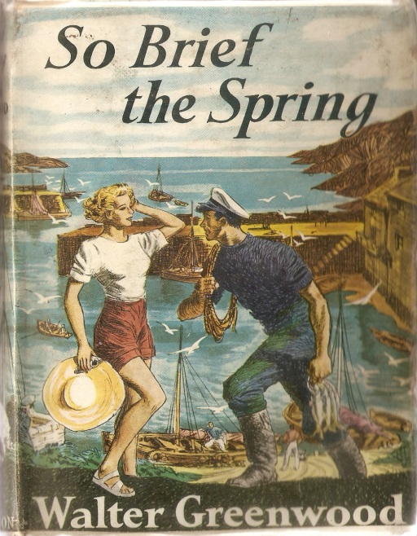
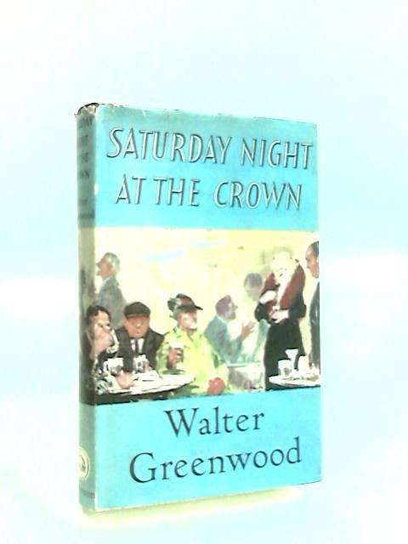
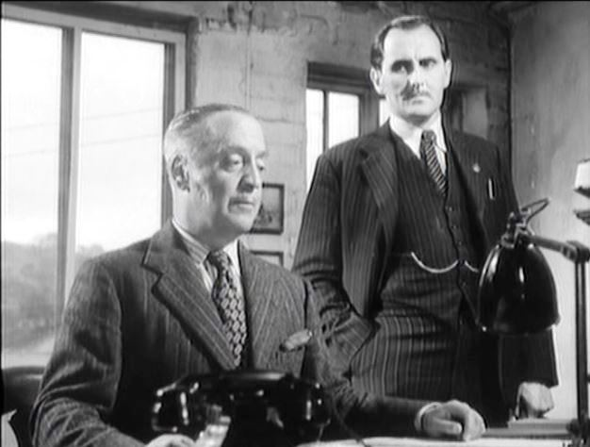
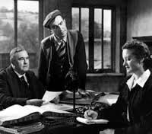
1950-1960: novels, plays, films
1952 novel: So Brief the Spring
1952 play: Too Clever for Love
1954 What Everybody Wants
1956 Down by the Sea
1956 play: Saturday Night at the Crown
1959 novel Saturday Night
at the Crown (1959)
1959 film Chance of a Lifetime.

Slide 16
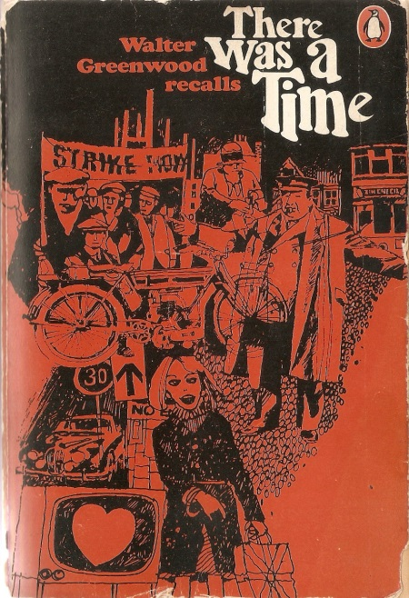
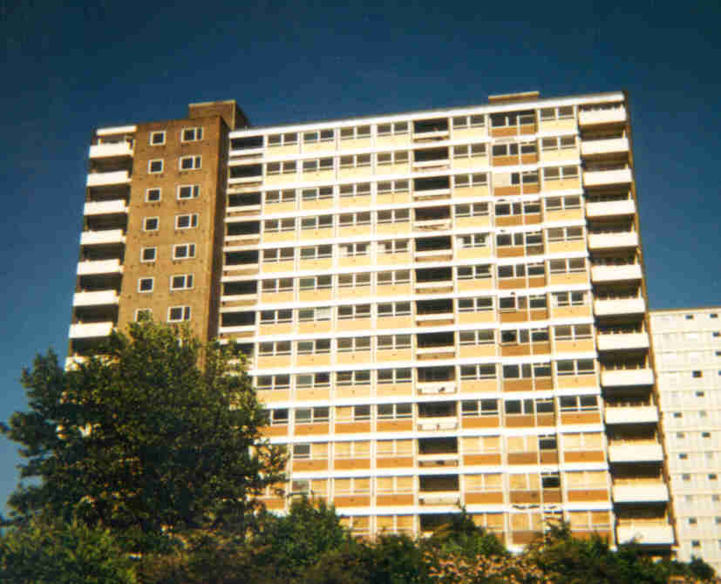
1960-1974: Looking Back
Meritorious children of my contemporaries ... are graduates of Oxbridge, Red-brick and the local school of Advanced Technology. Yesterday the Depression and lo! By a hop skip and a jump the Space Age and a Welfare State. A five-day, forty-hour week, holidays with pay, superannuation pension schemes, lunch vouchers and works’ canteens; an inrush of immigrants to fill the rising tide of jobs... and organised Labour in conference with employers on equal terms (p.251).
https://www.youtube.com/watch?v=J1xr1UwLbQ0
  (from 29.18 to 31.50)
1967 There was A Time
1967 play There was A Time (Hanky Park)
1971 musical Love on the Dole
1971 and 1973 interviews:
  The Guardian
  Kersel Flats (amateur)
1974 Dies peacefully in bed on 11 September (Kirkwall, Isle of Man)

Slide 17
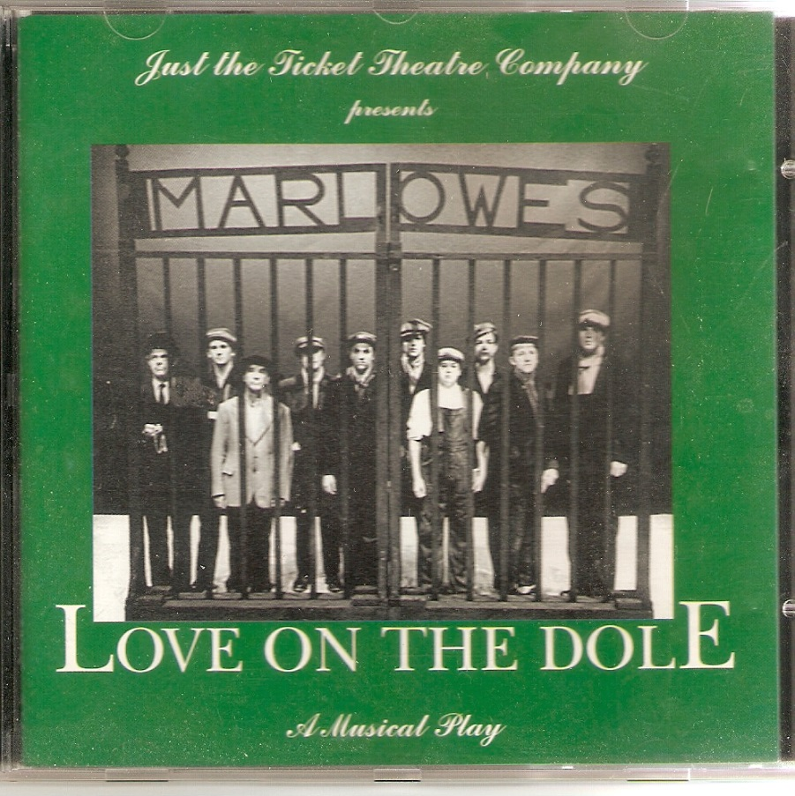
The Guardian: 'I was burning up inside with fury at the poverty around me ... it was a burning hatred but I realised this was no way to go about writing it down. This would be carrying a torch. I knew the most convincing way to present it was to get the characters right and a good story to tell it through' (to Catherine Stott)
'He is part of English literature and of the history of English society and taste...[he] is not a great highbrow master like D.H. Lawrence, but he is and always has been a truly popular writer – a man of the people who entertains all sorts and conditions and appeals instantly and directly to their hearts... The paradox and fascination of the book is that although the anger of the situation gave Walter Greenwood a pen of fire it is his approach to fiction that makes his work a classic' (by Keith Dewhurst)

