Slide 1
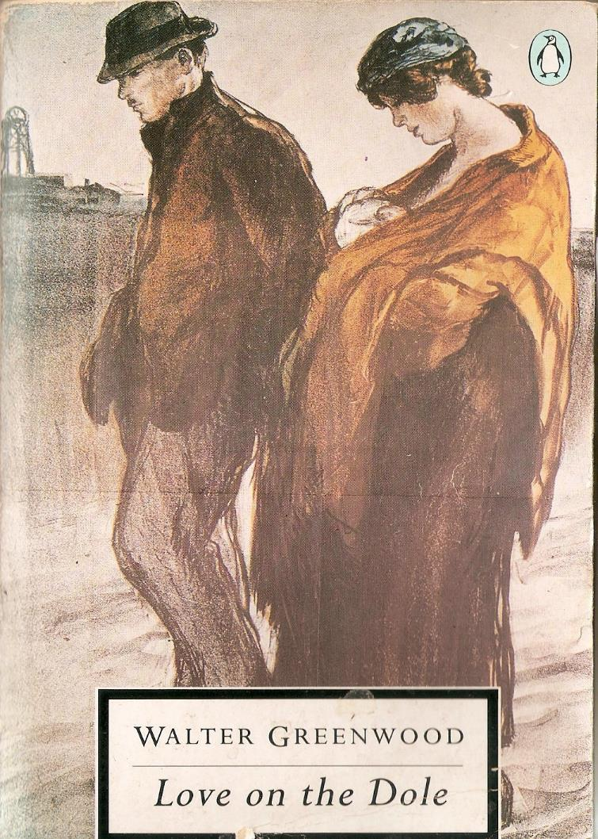
Genre/Mode/Image
Two Versions of the Unemployed City by Walter Greenwood / and Arthur Wragg (1933;1937)

Slide 2
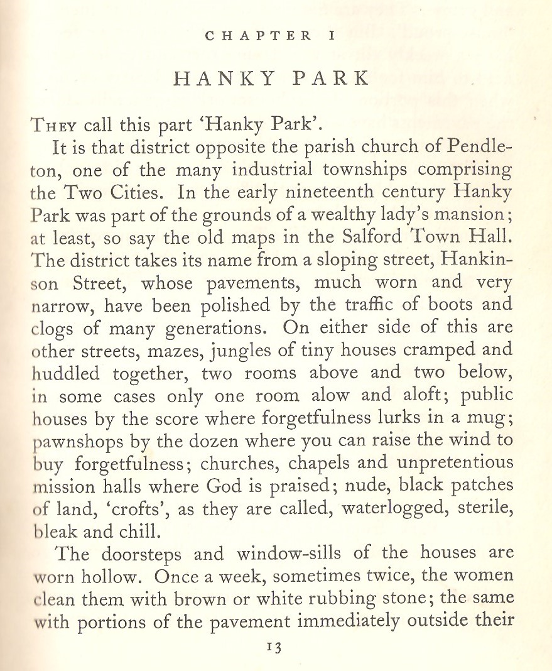
Love on the Dole – Genre + Mode?
both novel and play (1935) seen as highly realist
however, sometimes labelled ‘documentary’ too
maybe more in the tradition of the 19th c ‘Condition of England’ novel? (note character called ‘Mrs Cranford’ + north/south contrasts)
Look at techniques in the opening of LoD:
    How does this try to persuade the reader of the reality of Hanky Park? What kind of narrator?

Slide 3
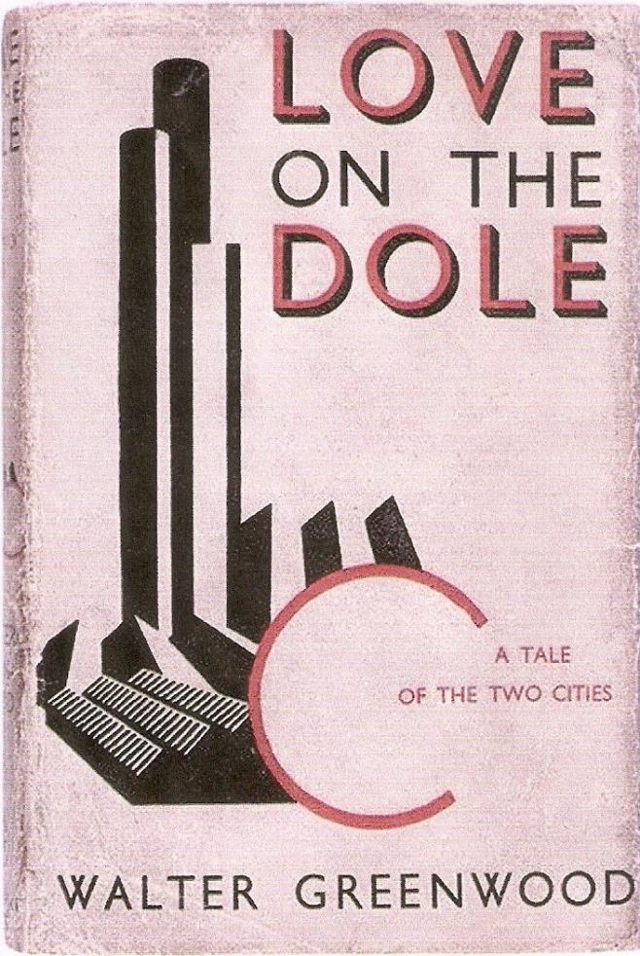
However, we might notice the design of the first edition dust-wrapper.
How good a fit is this image to the novel’s style + genre? Were readers being mislead by this cover?

Slide 4
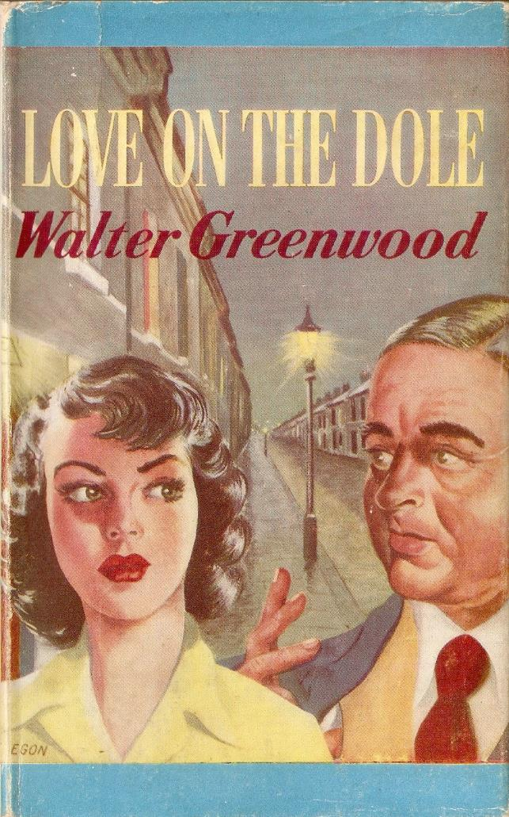
Overall, how conventional is the novel of Love on the Dole?
- how important is plot (working out for characters of consequences of cause and event?)
- how important is the narrator? And what kind of narrator?
- how ‘readerly’ (as opposed to ‘writerly’)?
- readers were, though, very struck by the novel doing something new and unusual; in what ways do you think it was original in 1933?

Slide 5
The genesis of Love on the Dole
Greenwood originally wrote short stories about Hanky Park between 1928 and 1931 while unemployed
he wanted to tell people about the (19th c?) conditions in Salford, and to make a living from writing
Only one was accepted by a short story magazine
a socialist popular novelist, Ethel Mannin, advised him to make his short stories into a novel if he wanted to make a living from such serious material
The first story he wrote was ‘Jack Cranford’s Wife’, later renamed ‘The Cleft Stick’, the overall title he also gave his short story collection of 1937: The Cleft Stick
The first published story was ‘The Maker of Books’ (in The Storyteller magazine, 1931).
However, he then turned his attention to writing a novel which drew on these stories and the world and characters of Hanky Park, but involved radical reshaping

Slide 6
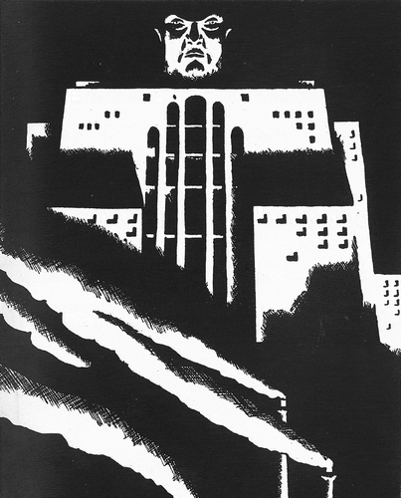
Greenwood mainly a realist, but had some contacts with modernism?
wrote a final Act for an unfinished D.H. Lawrence play, My Son’s My Son (performed at the Playhouse London, May 1936)
Joyce’s collection of linked short stories, Dubliners (1917), may influence the form of The Cleft Stick collection (1937)? It could perhaps have also influenced the form of the separate stories intended for magazine publication? Maybe too some Cleft Stick Stories show use of stream of consciousness?
His collaborator in the co-produced book The Cleft Stick, the artist Arthur Wragg, certainly drew on modernist as well as realist traditions – see e.g. Image for Psalm 30 from Psalms for Modern Life (1933).
    How do you read this image?

Slide 7
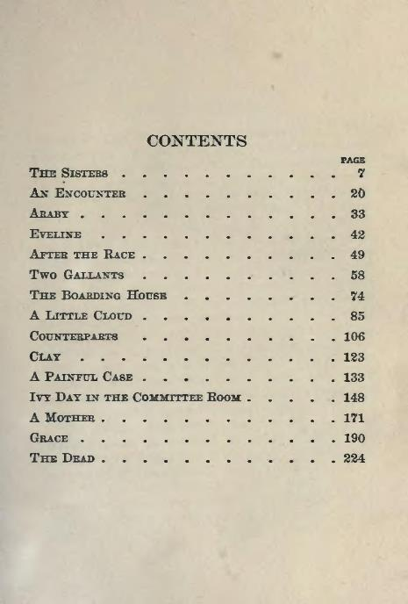
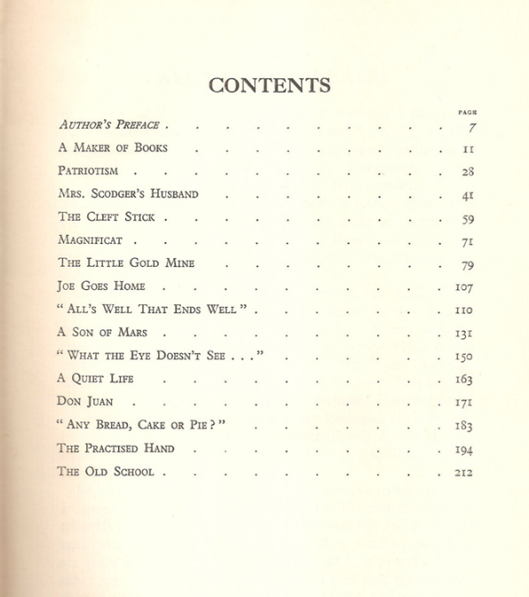
Greenwood’s original vision of Hanky Park was through 12 separate short stories, but he also saw these as a potential ‘collection’

Slide 8
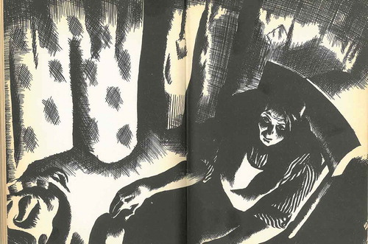
Next going to focus on two of those short stories
1. ‘The Cleft Stick’: written between 1928 and 1933
To what extent does it focus on an internal view of Mrs Cranford?
To what extent does it focus on her external environment?
how does it ask the reader to engage with her poverty? How prominent is the narrator? How unexpected do you think Mrs Bull’s reference to the menopause was in 1937?
how does Wragg’s illustration reinforce the story? Is this wholly a realist image?

Slide 9
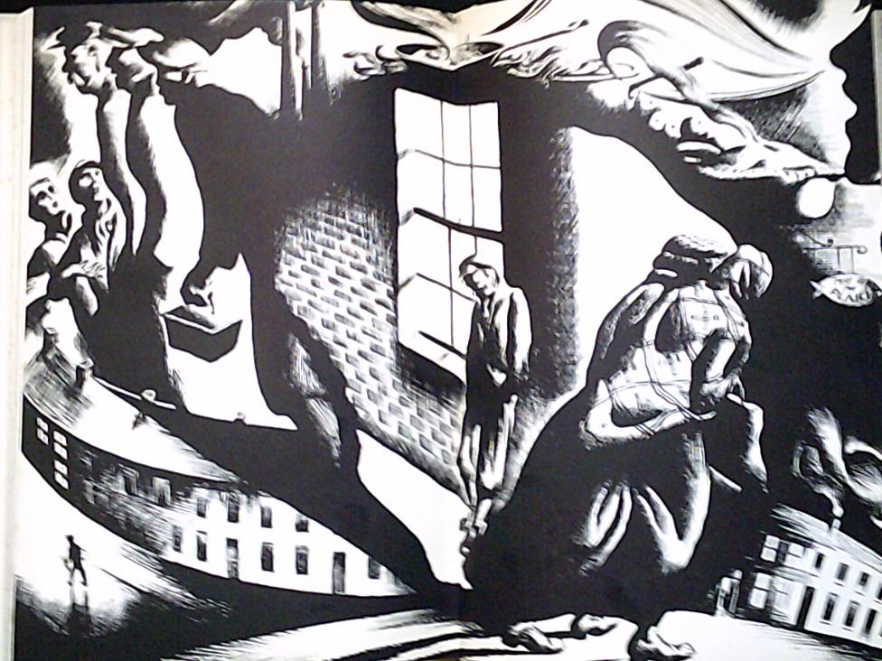
2. ‘ “Any Bread, Cake or Pie?” ‘
Again, to what extent is Harry represented from the inside and to what extent seen from the outside?
How does the narration of the story work to make the reader understand hunger?
How does Wragg’s picture imagine the experience of hunger? Is this even less of a realist representation than that of Mrs Cranford?

Slide 10
Overall, how different / similar is the representation of poverty + Hanky Park in Love on the Dole and The Cleft Stick?
How big a difference do the genres of novel and short story make to how Greenwood tells his stories?
Is Love on the Dole more conventional than The Cleft Stick?
The Cleft Stick was well-reviewed and generally seen as a sequel – but in some ways it was really a prequel, closer to Greenwood’s original vision of Salford – though also modified by Wragg’s visual contribution
Perhaps a version of The Cleft Stick published in 1933 might have looked more aesthetically radical – though not necessarily more socially radical than Love on the Dole? (but more difficult to adapt into a play or a film?)

Slide 11

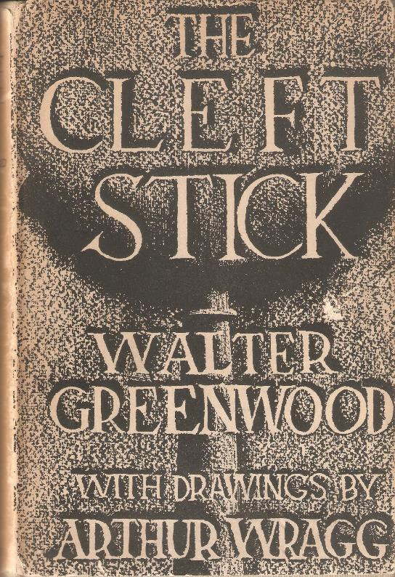
How different is Hanky Park in the cover designs of Love on the Dole and The Cleft Stick?

Slide 12
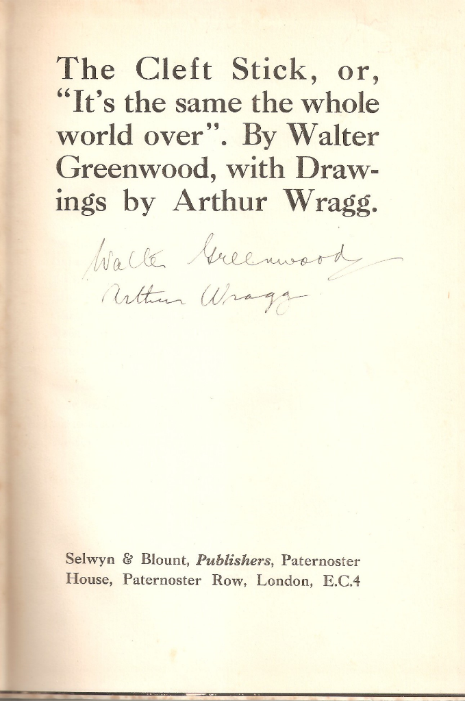
Any Questions?
(for more on WG see: https://waltergreenwoodnotjustloveonthedole.com/)

